Slide 1
Section 7.8
Phase Shift;
Sinusoidal Curve Fitting
Copyright © 2012 Pearson Education, Inc. Publishing as Prentice Hall.

Slide 2

Copyright © 2012 Pearson Education, Inc. Publishing as Prentice Hall.

Slide 3
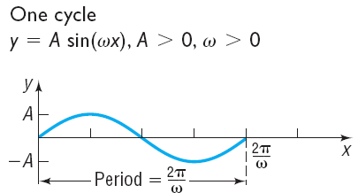
Copyright © 2012 Pearson Education, Inc. Publishing as Prentice Hall.

Slide 4
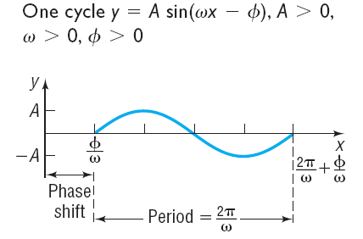
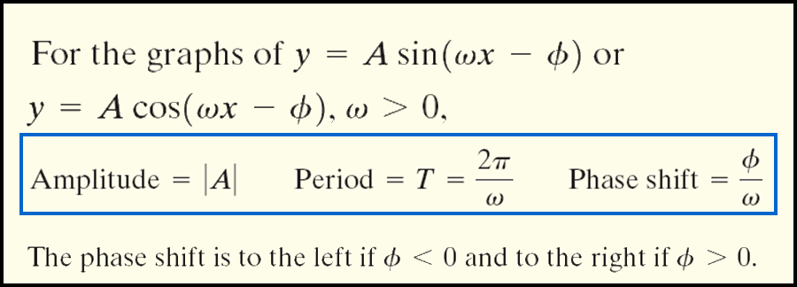
Copyright © 2012 Pearson Education, Inc. Publishing as Prentice Hall.

Slide 5

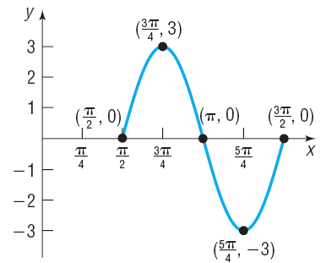
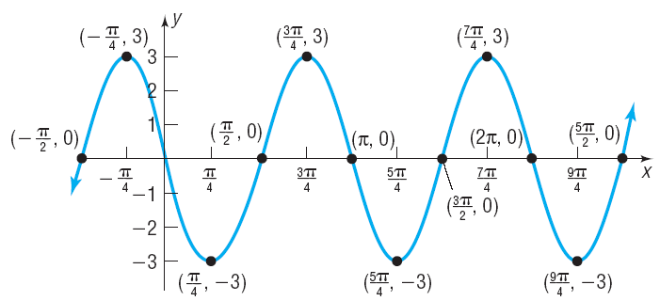
Copyright © 2012 Pearson Education, Inc. Publishing as Prentice Hall.

Slide 6
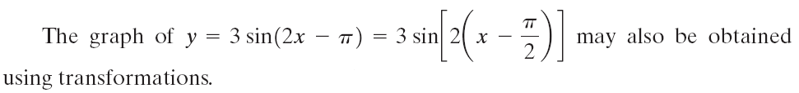
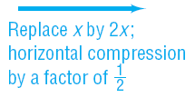
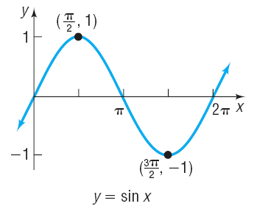
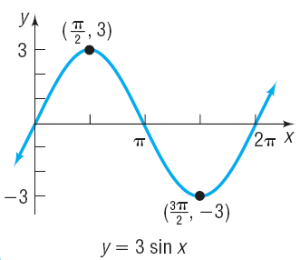

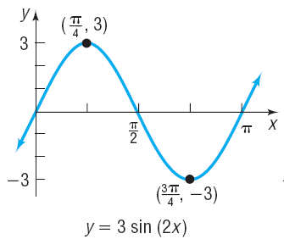
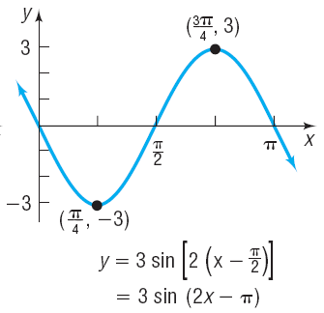
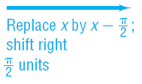
Copyright © 2012 Pearson Education, Inc. Publishing as Prentice Hall.

Slide 7
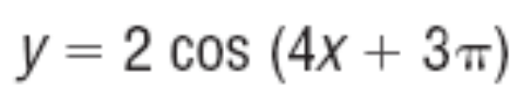
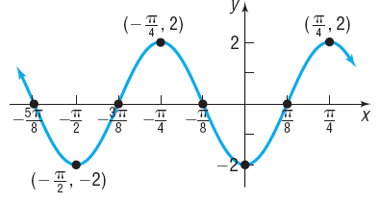
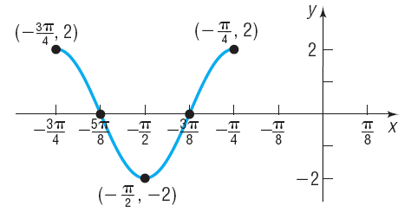
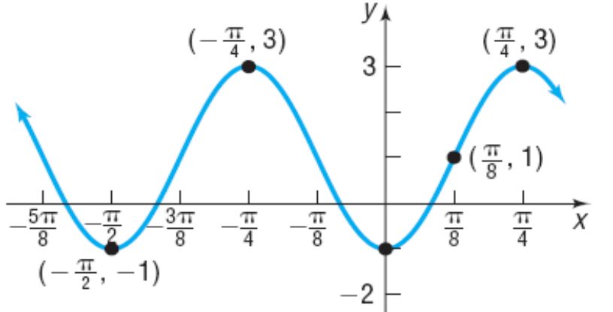
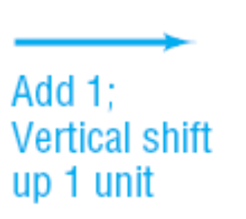

Copyright © 2012 Pearson Education, Inc. Publishing as Prentice Hall.

Slide 8
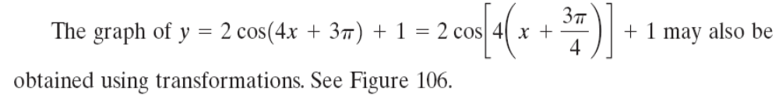
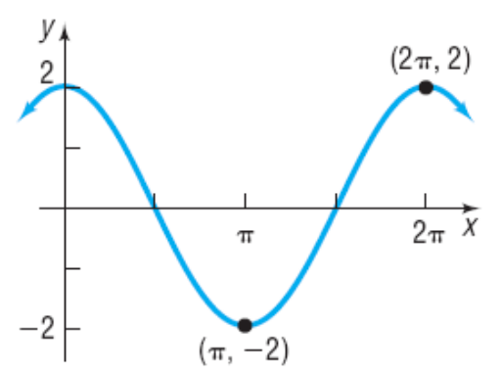
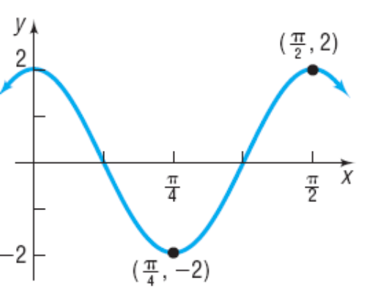



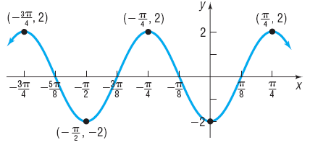
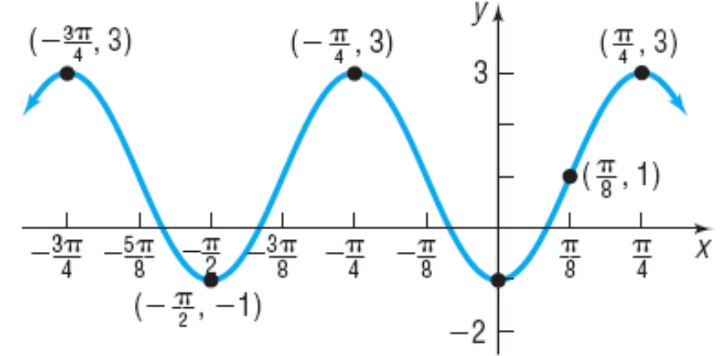
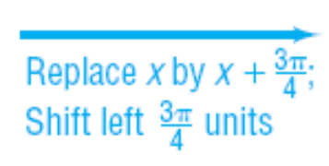
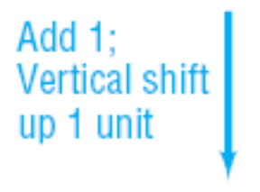


Copyright © 2012 Pearson Education, Inc. Publishing as Prentice Hall.

Slide 9
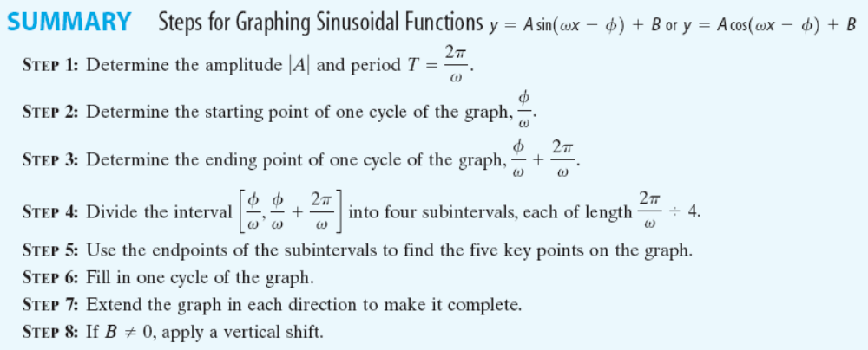
Copyright © 2012 Pearson Education, Inc. Publishing as Prentice Hall.

Slide 10
Copyright © 2012 Pearson Education, Inc. Publishing as Prentice Hall.

Slide 11
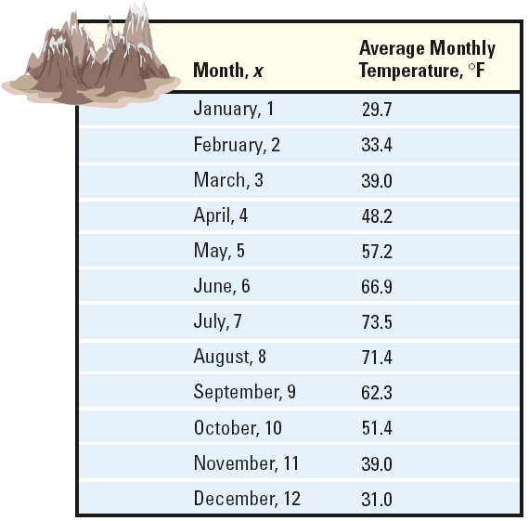
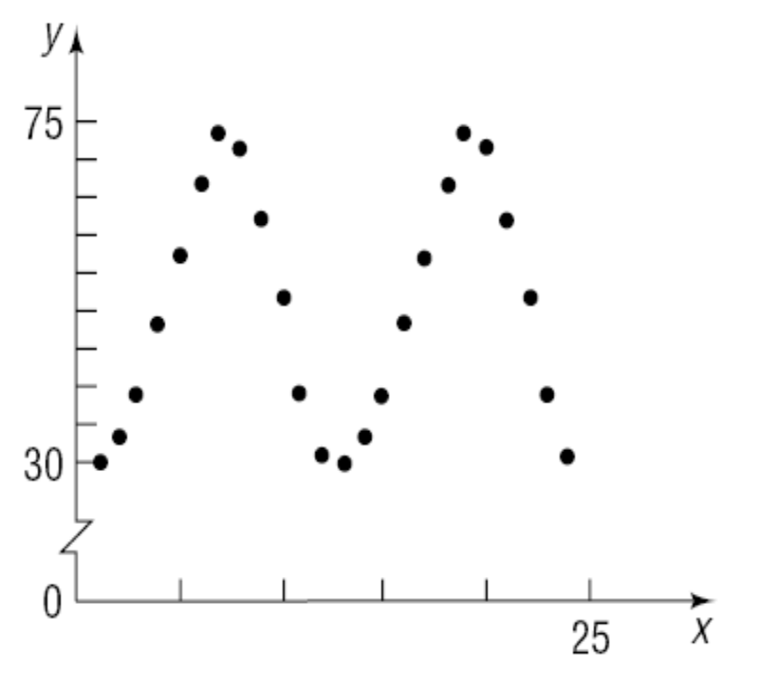
Copyright © 2012 Pearson Education, Inc. Publishing as Prentice Hall.

Slide 12
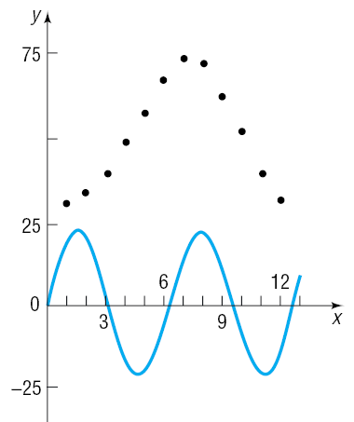
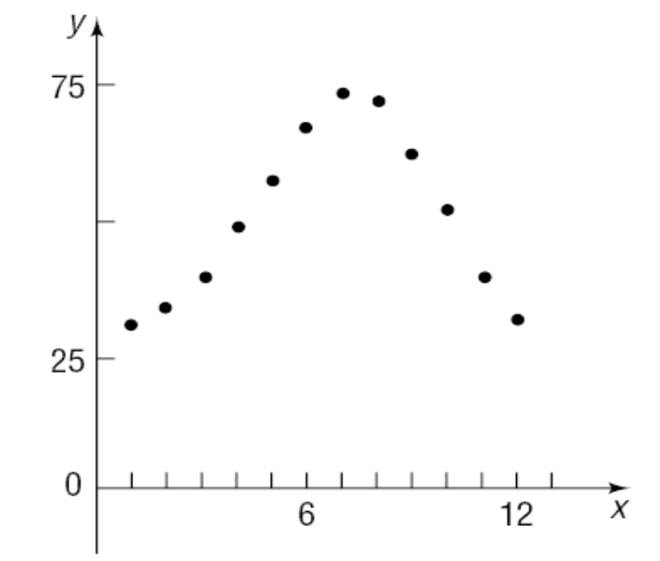


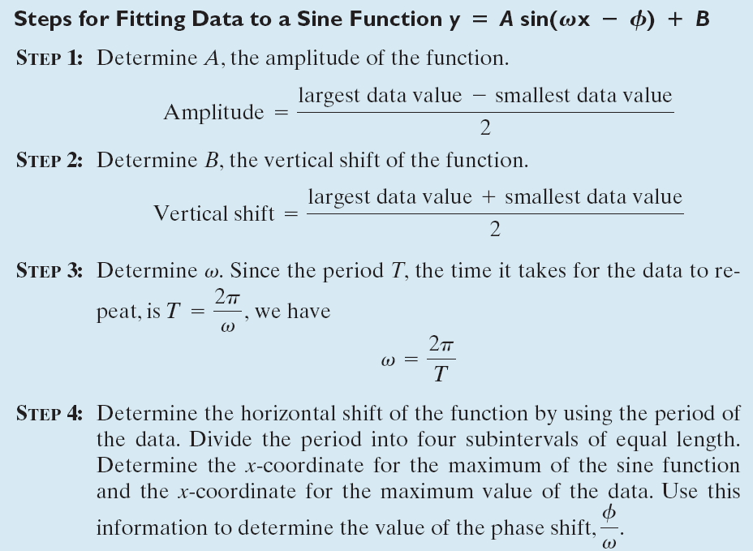
(on previous slide)
Copyright © 2012 Pearson Education, Inc. Publishing as Prentice Hall.

Slide 13
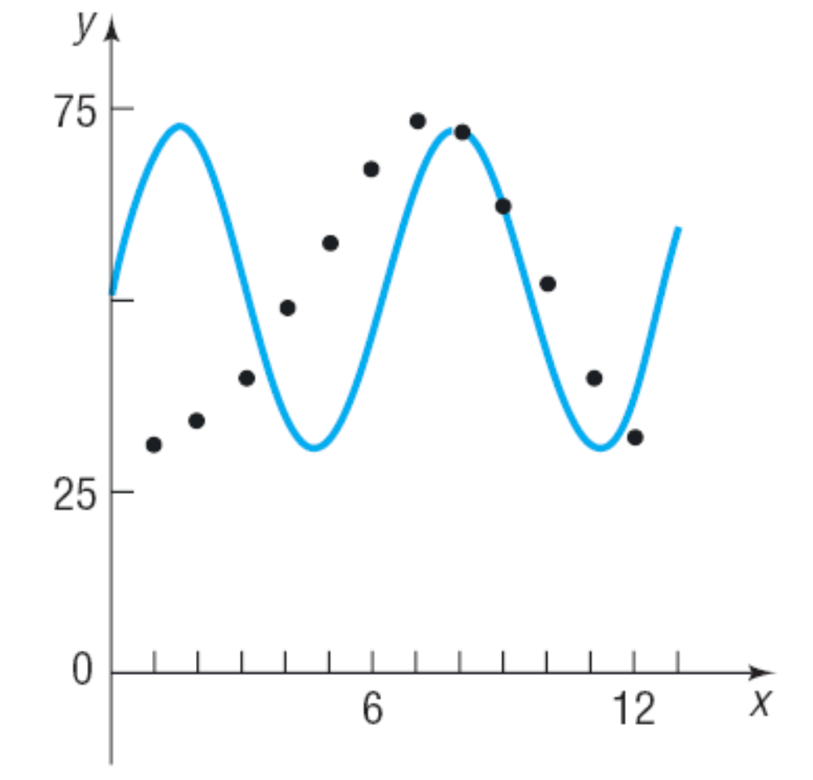

Copyright © 2012 Pearson Education, Inc. Publishing as Prentice Hall.

Slide 14
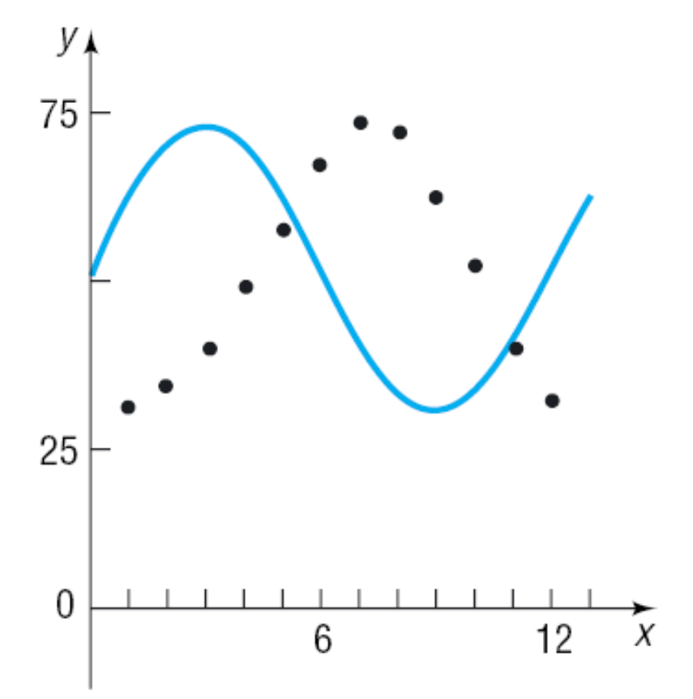


Copyright © 2012 Pearson Education, Inc. Publishing as Prentice Hall.

Slide 15
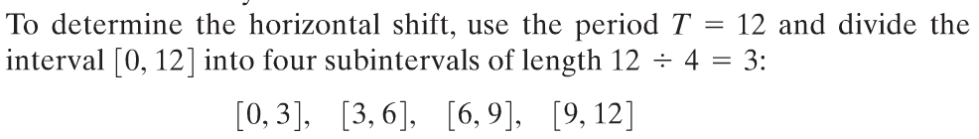
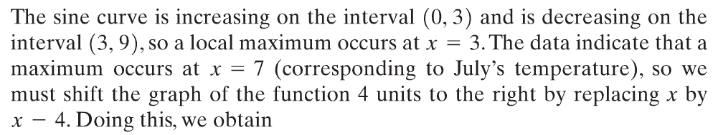

Copyright © 2012 Pearson Education, Inc. Publishing as Prentice Hall.

Slide 16
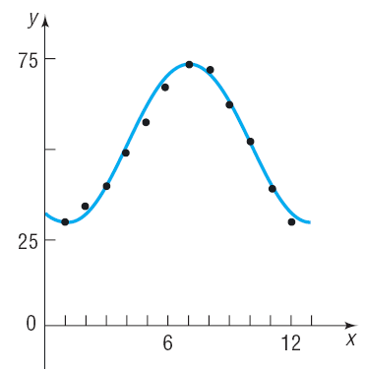
Copyright © 2012 Pearson Education, Inc. Publishing as Prentice Hall.

Slide 17
Copyright © 2012 Pearson Education, Inc. Publishing as Prentice Hall.

Slide 18
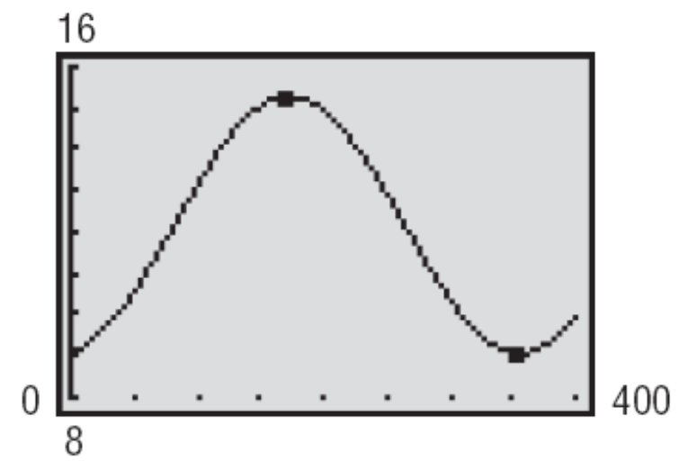
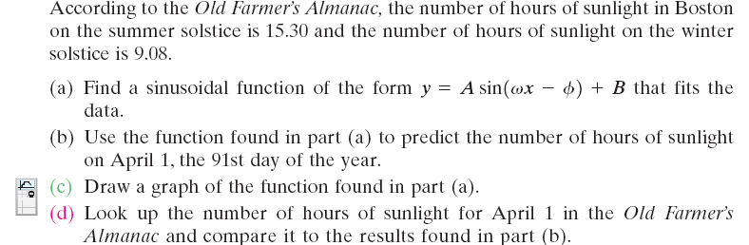
Copyright © 2012 Pearson Education, Inc. Publishing as Prentice Hall.

Slide 19
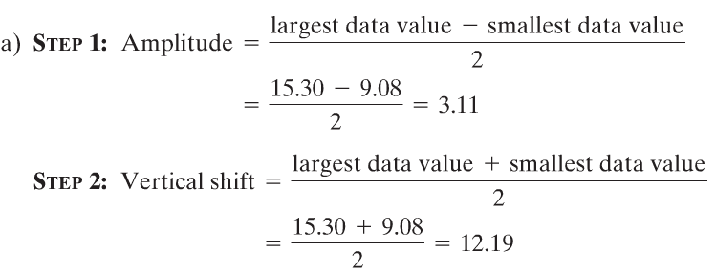
Copyright © 2012 Pearson Education, Inc. Publishing as Prentice Hall.

Slide 20
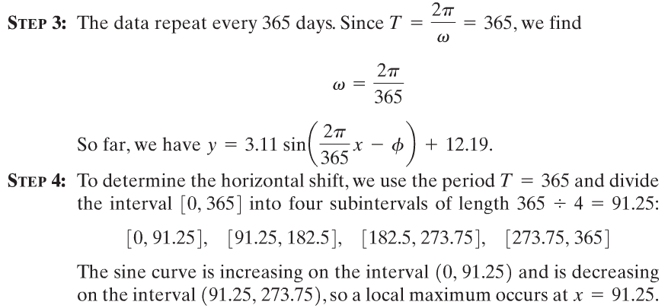
Copyright © 2012 Pearson Education, Inc. Publishing as Prentice Hall.

Slide 21
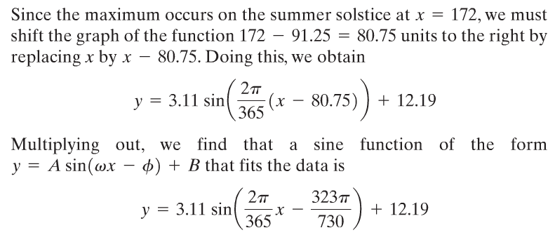
Copyright © 2012 Pearson Education, Inc. Publishing as Prentice Hall.

Slide 22
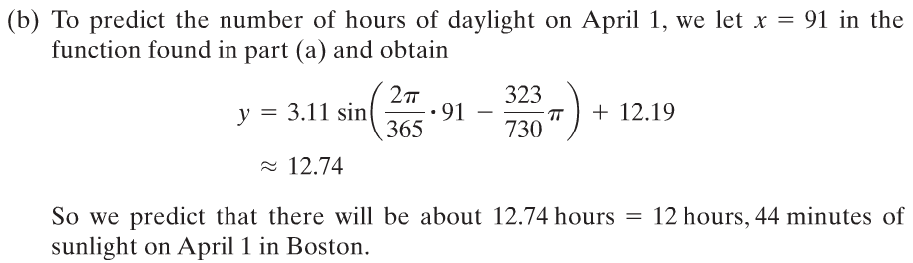
Copyright © 2012 Pearson Education, Inc. Publishing as Prentice Hall.

Slide 23
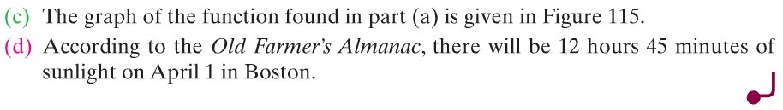
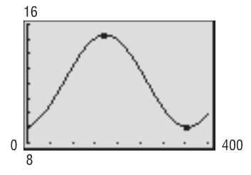
Copyright © 2012 Pearson Education, Inc. Publishing as Prentice Hall.
Figure 115

Slide 24
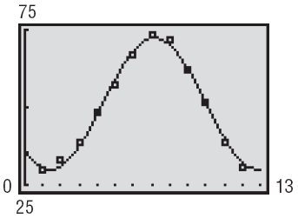
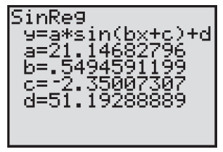
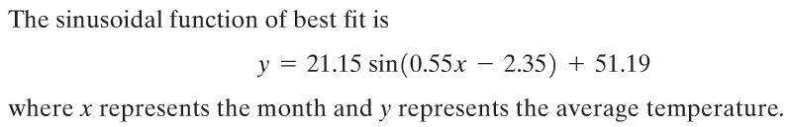
Copyright © 2012 Pearson Education, Inc. Publishing as Prentice Hall.

